Slide 1
Chapter 22: Object-Based Databases

Slide 2
Chapter 22: Object-Based Databases
Complex Data Types and Object Orientation
Structured Data Types and Inheritance in SQL
Table Inheritance
Array and Multiset Types in SQL
Object Identity and Reference Types in SQL
Implementing O-R Features

Slide 3
Object-Relational Data Models
Extend the relational data model by including object orientation and constructs to deal with added data types.
Allow attributes of tuples to have complex types, including non-atomic values such as nested relations.
Preserve relational foundations, in particular the declarative access to data, while extending modeling power.
Upward compatibility with existing relational languages.

Slide 4
Complex Data Types
Motivation:
  Permit non-atomic domains (atomic ≡ indivisible)
  Example of non-atomic domain: set of integers,or set of tuples
  Allows more intuitive modeling for applications with complex data
Intuitive definition:
  allow relations whenever we allow atomic (scalar) values — relations within relations
  Retains mathematical foundation of relational model
  Violates first normal form.

Slide 5
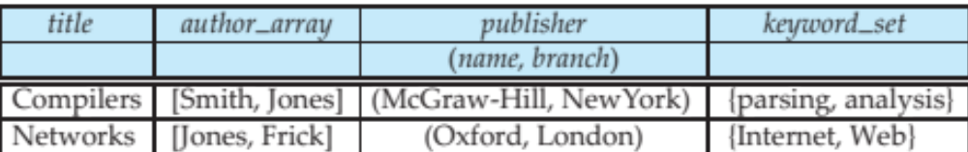
Example of a Nested Relation
Example: library information system
Each book has
  title,
  a list (array) of authors,
  Publisher, with subfields name and branch, and
  a set of keywords
Non-1NF relation books

Slide 6
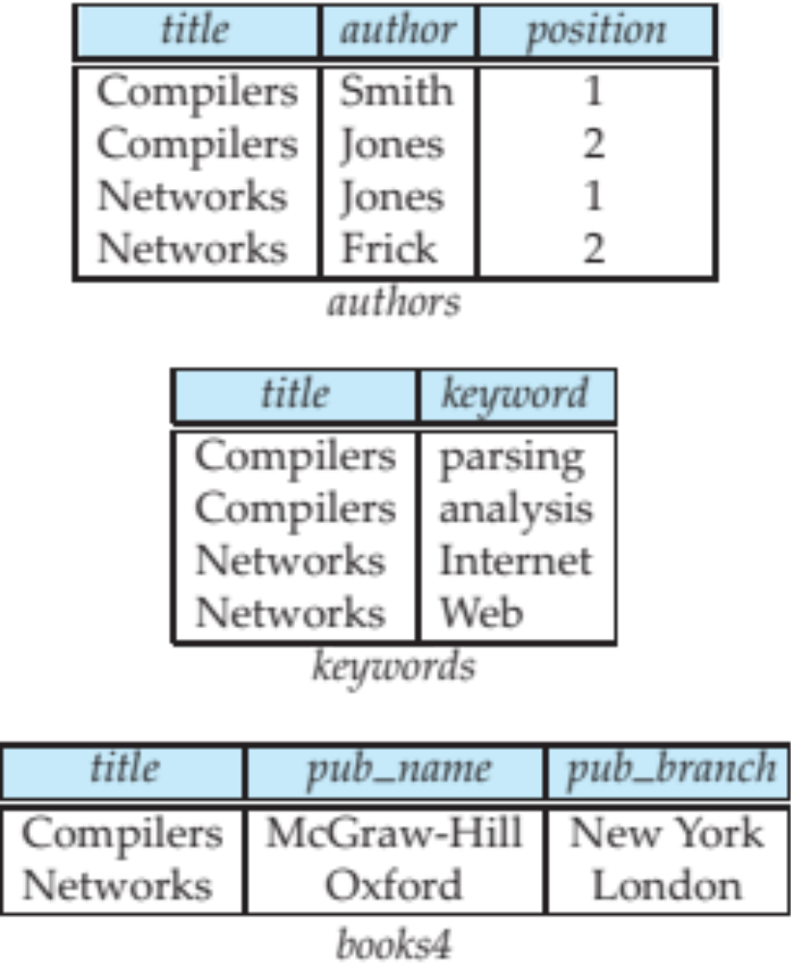
4NF Decomposition of Nested Relation
Suppose for simplicity that title uniquely identifies a book
  In real world ISBN is a unique identifier
Decompose books into 4NF using the schemas:
  (title, author, position )
  (title, keyword )
  (title, pub-name, pub-branch )
4NF design requires users to include joins in their queries.

Slide 7
Complex Types and SQL
Extensions introduced in SQL:1999 to support complex types:
  Collection and large object types
    Nested relations are an example of collection types
  Structured types
    Nested record structures like composite attributes
  Inheritance
  Object orientation
    Including object identifiers and references
Not fully implemented in any database system currently
  But some features are present in each of the major commercial database systems
    Read the manual of your database system to see what it supports

Slide 8
Structured Types and Inheritance in SQL
Structured types (a.k.a. user-defined types) can be declared and used in SQL
create type Name as
(firstname varchar(20),
lastname varchar(20))
final
create type Address as
(street varchar(20),
city varchar(20),
zipcode varchar(20))
not final
  Note: final and not final indicate whether subtypes can be created
Structured types can be used to create tables with composite attributes
create table person (
name Name,
address Address,
dateOfBirth date)
Dot notation used to reference components: name.firstname

Slide 9
Structured Types (cont.)
User-defined row types
  create type PersonType as (
  name Name,
  address Address,
  dateOfBirth date)
  not final
Can then create a table whose rows are a user-defined type
create table person of PersonType
Alternative using unnamed row types.
create table person_r(
name row(firstname varchar(20),
lastname varchar(20)),
address row(street varchar(20),
city varchar(20),
zipcode varchar(20)),
dateOfBirth date)

Slide 10
Methods
Can add a method declaration with a structured type.
method ageOnDate (onDate date)
returns interval year
Method body is given separately.
  create instance method ageOnDate (onDate date)
  returns interval year
  for CustomerType
  begin
  return onDate - self.dateOfBirth;
  end
We can now find the age of each customer:
  select name.lastname, ageOnDate (current_date)
  from customer

Slide 11
Constructor Functions
Constructor functions are used to create values of structured types
E.g.
create function Name(firstname varchar(20), lastname varchar(20))
returns Name
begin
set self.firstname = firstname;
set self.lastname = lastname;
end
To create a value of type Name, we use
new Name(‘John’, ‘Smith’)
Normally used in insert statements
insert into Person values
(new Name(‘John’, ‘Smith),
new Address(’20 Main St’, ‘New York’, ‘11001’),
date ‘1960-8-22’);

Slide 12
Type Inheritance
Suppose that we have the following type definition for people:
create type Person
(name varchar(20),
address varchar(20))
Using inheritance to define the student and teacher types
create type Student
under Person
(degree varchar(20),
department varchar(20))
create type Teacher
under Person
(salary integer,
department varchar(20))
Subtypes can redefine methods by using overriding method in place of method in the method declaration

Slide 13
Multiple Type Inheritance
SQL:1999 and SQL:2003 do not support multiple inheritance
If our type system supports multiple inheritance, we can define a type for teaching assistant as follows:
create type Teaching Assistant
under Student, Teacher
To avoid a conflict between the two occurrences of department we can rename them
create type Teaching Assistant
under
Student with (department as student_dept ),
Teacher with (department as teacher_dept )
Each value must have a most-specific type

Slide 14
Table Inheritance
Tables created from subtypes can further be specified as subtables
E.g. create table people of Person;
create table students of Student under people;
create table teachers of Teacher under people;
Tuples added to a subtable are automatically visible to queries on the supertable
  E.g. query on people also sees students and teachers.
  Similarly updates/deletes on people also result in updates/deletes on subtables
  To override this behaviour, use “only people” in query
Conceptually, multiple inheritance is possible with tables
  e.g. teaching_assistants under students and teachers
  But is not supported in SQL currently
    So we cannot create a person (tuple in people) who is both a student and a teacher

Slide 15
Consistency Requirements for Subtables
Consistency requirements on subtables and supertables.
  Each tuple of the supertable (e.g. people) can correspond to at most one tuple in each of the subtables (e.g. students and teachers)
  Additional constraint in SQL:1999:
  All tuples corresponding to each other (that is, with the same values for inherited attributes) must be derived from one tuple (inserted into one table).
    That is, each entity must have a most specific type
    We cannot have a tuple in people corresponding to a tuple each in students and teachers

Slide 16
Array and Multiset Types in SQL
Example of array and multiset declaration:
create type Publisher as
(name varchar(20),
branch varchar(20));
create type Book as
(title varchar(20),
author_array varchar(20) array [10],
pub_date date,
publisher Publisher,
keyword-set varchar(20) multiset);
create table books of Book;

Slide 17
Creation of Collection Values
Array construction
array [‘Silberschatz’,`Korth’,`Sudarshan’]
Multisets
  multiset [‘computer’, ‘database’, ‘SQL’]
To create a tuple of the type defined by the books relation: (‘Compilers’, array[`Smith’,`Jones’],
new Publisher (`McGraw-Hill’,`New York’), multiset [`parsing’,`analysis’ ])
To insert the preceding tuple into the relation books
insert into books
values
(‘Compilers’, array[`Smith’,`Jones’],
new Publisher (`McGraw-Hill’,`New York’),
multiset [`parsing’,`analysis’ ]);

Slide 18
Querying Collection-Valued Attributes
To find all books that have the word “database” as a keyword,
select title
from books
where ‘database’ in (unnest(keyword-set ))
We can access individual elements of an array by using indices
  E.g.: If we know that a particular book has three authors, we could write:
select author_array[1], author_array[2], author_array[3]
from books
where title = `Database System Concepts’
To get a relation containing pairs of the form “title, author_name” for each book and each author of the book
select B.title, A.author
from books as B, unnest (B.author_array) as A (author )
To retain ordering information we add a with ordinality clause
select B.title, A.author, A.position
from books as B, unnest (B.author_array) with ordinality as
A (author, position )

Slide 19
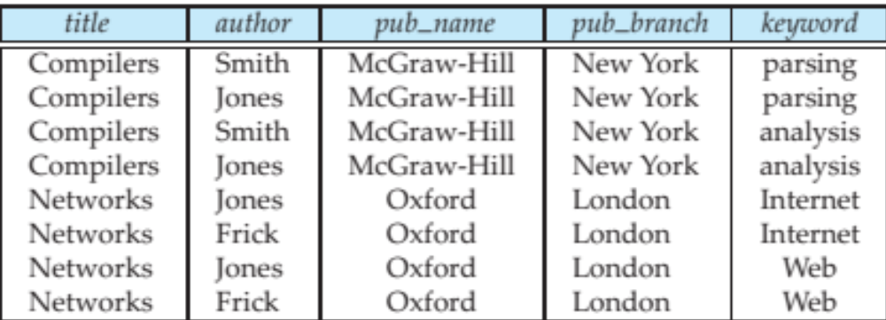
Unnesting
The transformation of a nested relation into a form with fewer (or no) relation-valued attributes is called unnesting.
E.g.
select title, A.author, publisher.name as pub_name,
publisher.branch as pub_branch, K.keyword
from books as B, unnest(B.author_array ) as A (author ),
unnest (B.keyword_set ) as K (keyword )
Result relation flat_books

Slide 20
Nesting
Nesting is the opposite of unnesting, creating a collection-valued attribute
Nesting can be done in a manner similar to aggregation, but using the function colect() in place of an aggregation operation, to create a multiset
To nest the flat_books relation on the attribute keyword:
select title, author, Publisher (pub_name, pub_branch ) as publisher,
collect (keyword) as keyword_set
from flat_books
groupby title, author, publisher
To nest on both authors and keywords:
select title, collect (author ) as author_set,
Publisher (pub_name, pub_branch) as publisher,
collect (keyword ) as keyword_set
from flat_books
group by title, publisher

Slide 21
Object-Identity and Reference Types
Define a type Department with a field name and a field head which is a reference to the type Person, with table people as scope:
create type Department (
name varchar (20),
head ref (Person) scope people)
We can then create a table departments as follows
create table departments of Department
We can omit the declaration scope people from the type declaration and instead make an addition to the create table statement:
create table departments of Department
(head with options scope people)
Referenced table must have an attribute that stores the identifier, called the self-referential attribute
create table people of Person
ref is person_id system generated;

Slide 22
Initializing Reference-Typed Values
To create a tuple with a reference value, we can first create the tuple with a null reference and then set the reference separately:
insert into departments
values (`CS’, null)
update departments
set head = (select p.person_id
from people as p
where name = `John’)
where name = `CS’

Slide 23
User Generated Identifiers
The type of the object-identifier must be specified as part of the type definition of the referenced table, and
The table definition must specify that the reference is user generated
create type Person
(name varchar(20)
address varchar(20))
ref using varchar(20)
create table people of Person
ref is person_id user generated
When creating a tuple, we must provide a unique value for the identifier:
  insert into people (person_id, name, address ) values
  (‘01284567’, ‘John’, `23 Coyote Run’)
We can then use the identifier value when inserting a tuple into departments
  Avoids need for a separate query to retrieve the identifier:
insert into departments
values(`CS’, `02184567’)

